Slide 1

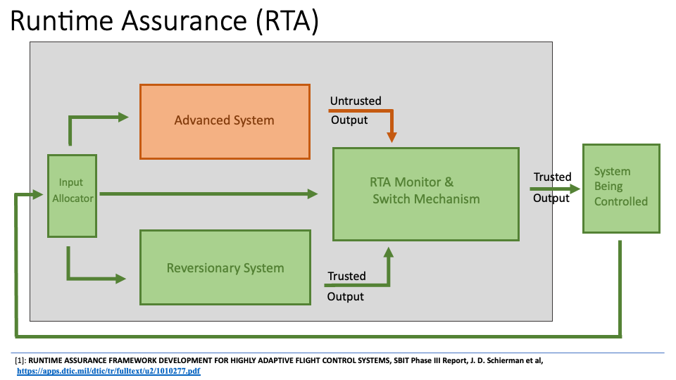
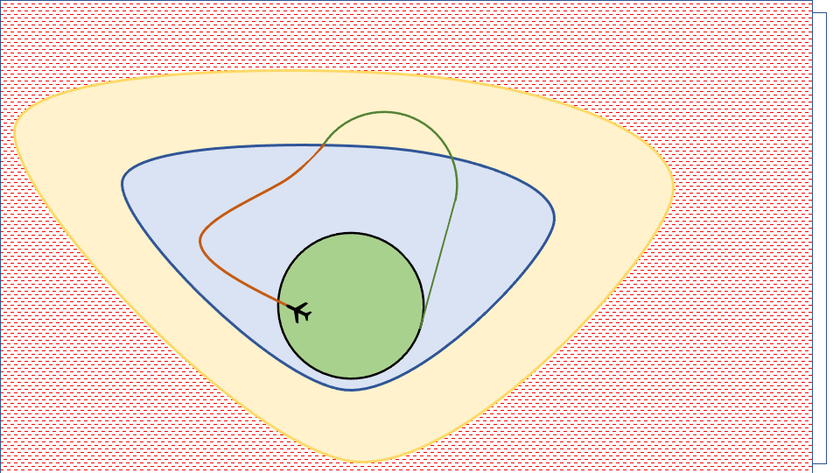

Why Proofs Matter: Proving Safety in Aircraft Systems
Berea Undergraduate Research and Internship Symposium
Berea College
Oct 20th, 2023
J Tanner Slagel
NASA Langley Research Center

Slide 2
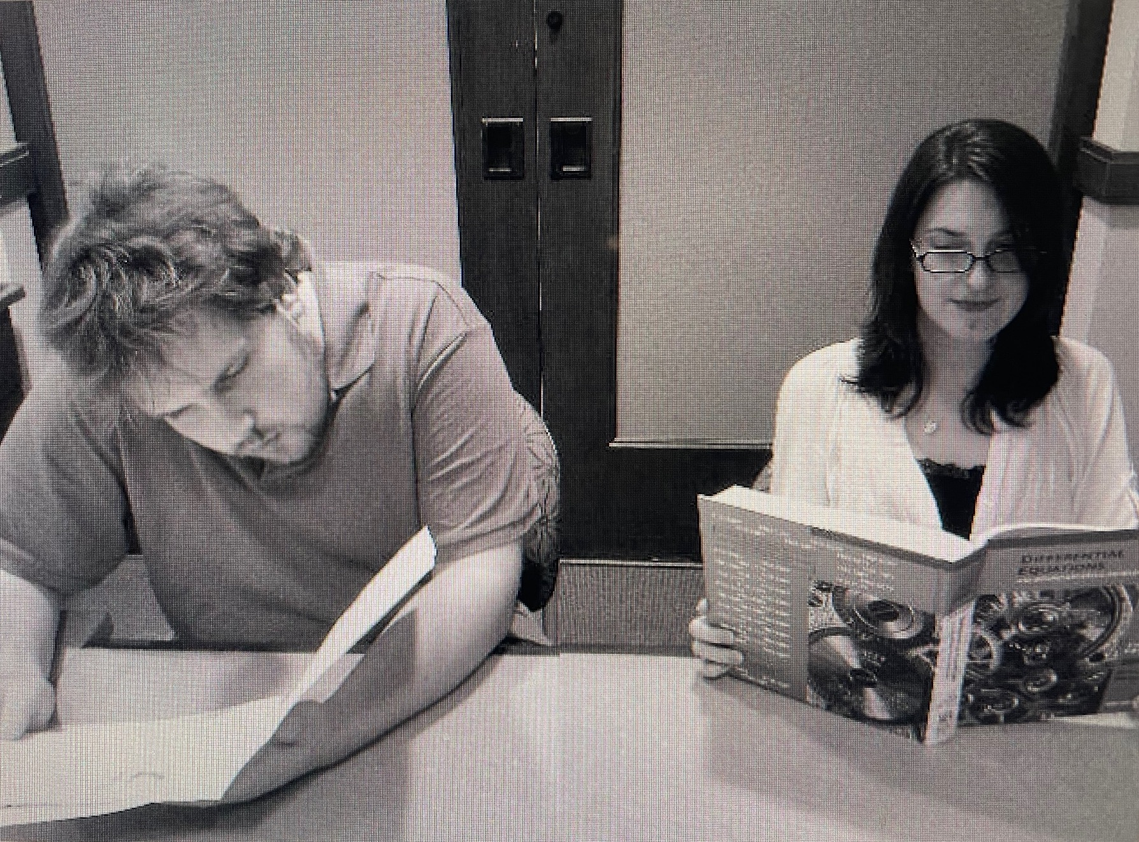
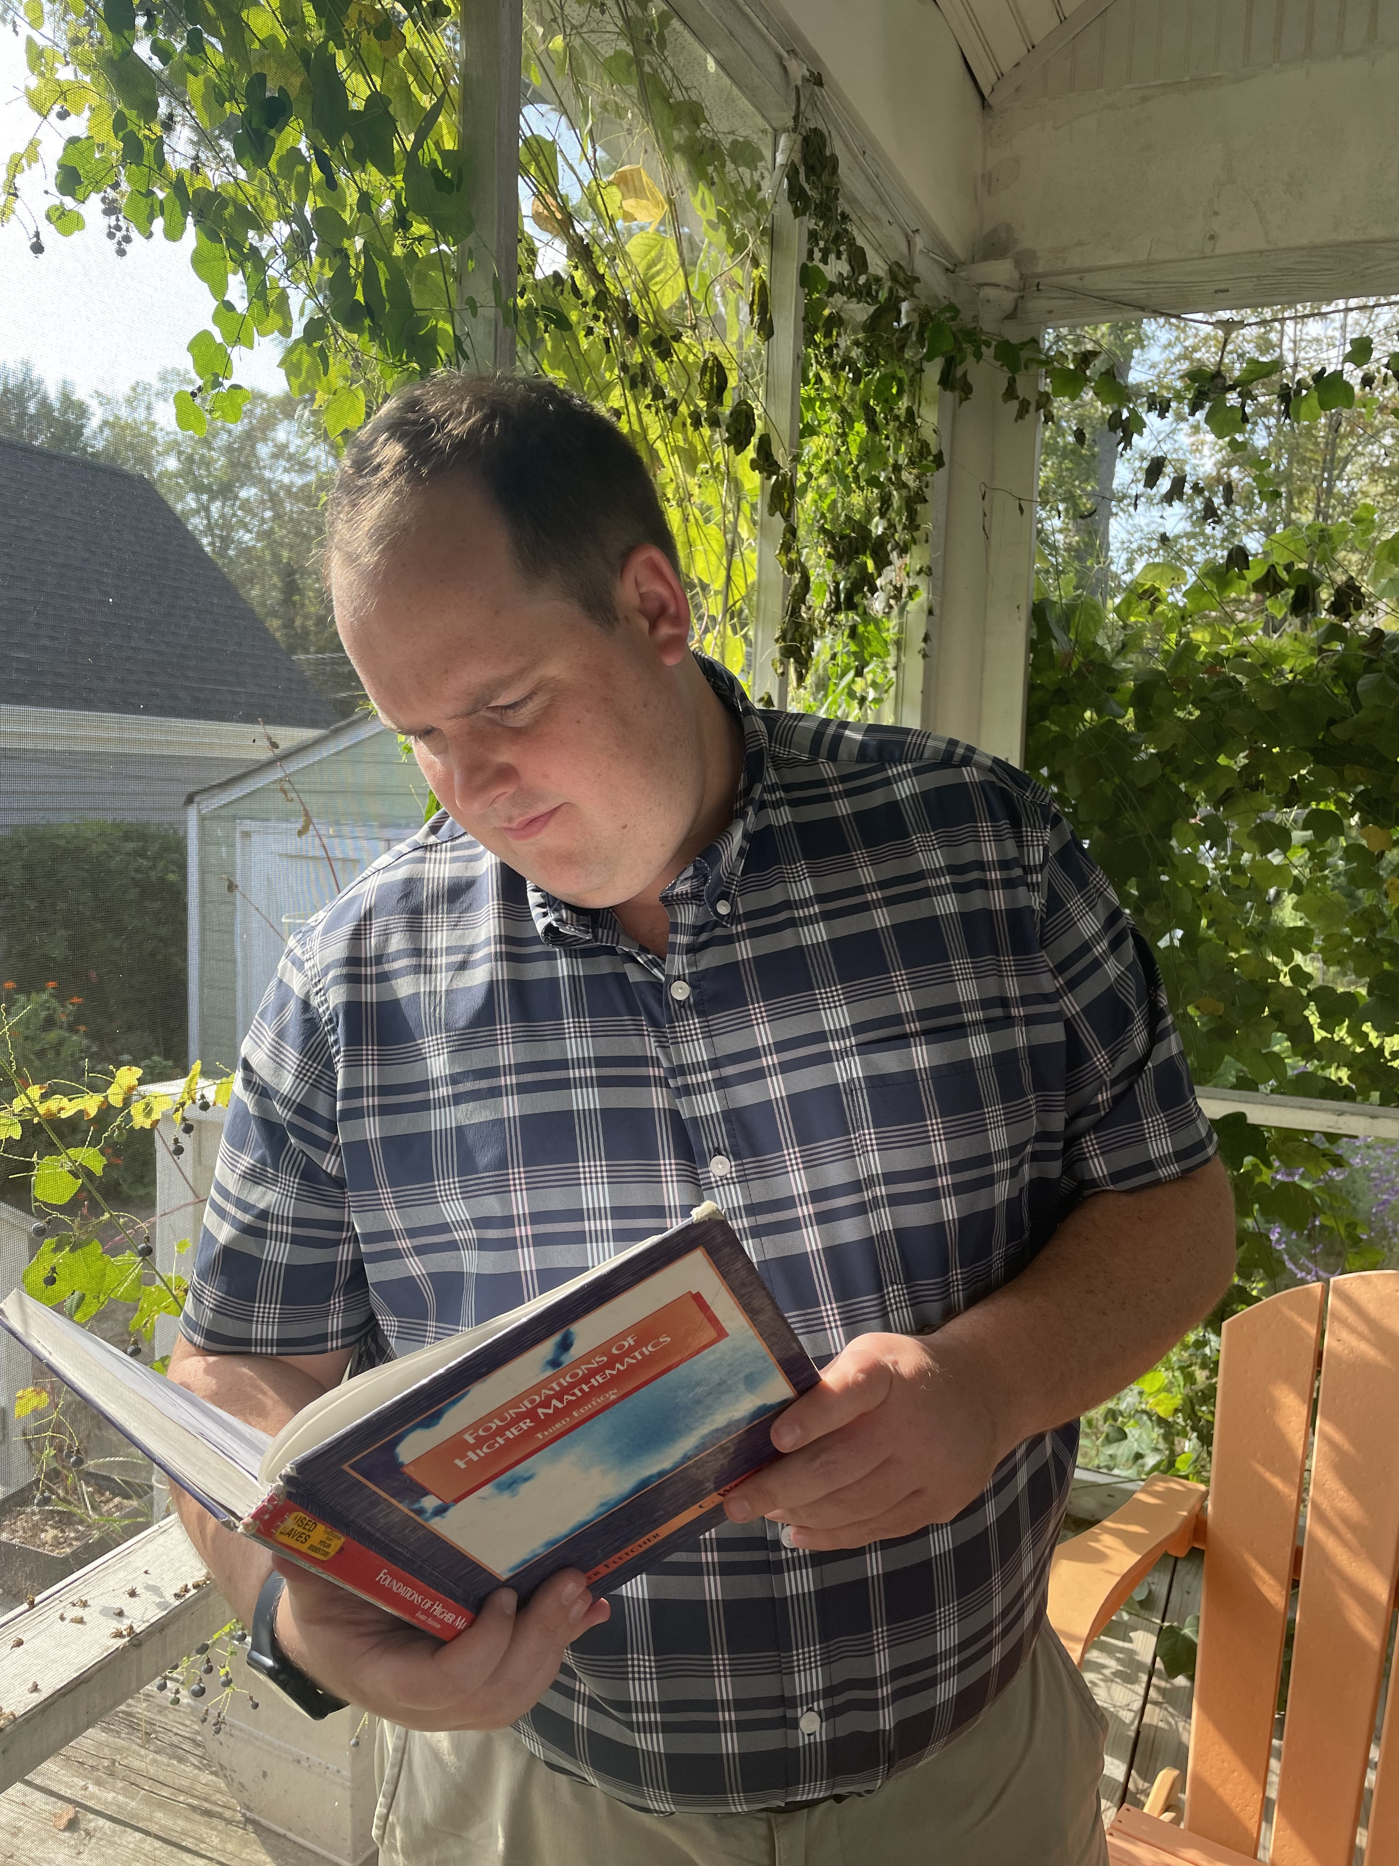
…I used to go here
2012, Dr. Rachel Barber and Tanner
Picture for undergraduate research talk
2023
Notes:
Hey Everyone welcome, let's start by watching a video This video is of a F-16 in 2016 almost crashing just a spoiler alert it doesn't crash and the pilot ends up being fine:
Alright so what did we just see. This video is of the HUD display of a student pilot from the Arizona Air National Guard’s 152nd Fighter Squadron, and the pilot executes a maneuver and because of the resulting 8.2 G forces the Pilot loses consciousness
About 11 seconds later the F-16 is pointed 50 degree below the horizon, going a little over the speed of sound at 11.8 thousand feet. In this situation the 'floor' is 12,000 feet which is considered the minimal acceptable altitude for the F-16 to be at.
Four seconds later the aircraft is at 8570 feet, so lost about 3500 feet in 4 seconds, and the AUTO-GCAS system activates, performing a 'Fly UP' maneuver at where it takes control of the F-16 while the pilot is incapacitated. The maneuver results in a force of 9.1 Gs, but it pulls the noise of the F-16 up and eventually the pilot recovers and the F-16 gets back above the 'floor' of 12,000 ft.
So Auto-Gcas eps the the automatic ground collision avoidance system that has been developed over several decades for situations like these, developed by Lockheed Martin and NASA Armstrong and the Airfare research laboratory not by my be at all). And what we just saw is an example of this technology saving a pilot's life.

Slide 3
What is a proof?
Proof:
Statement to be proved
Assumptions
Assumptions
Logical Deductions
Conclusion
Conclusion
Notes:
Hey Everyone welcome, let's start by watching a video This video is of a F-16 in 2016 almost crashing just a spoiler alert it doesn't crash and the pilot ends up being fine:
Alright so what did we just see. This video is of the HUD display of a student pilot from the Arizona Air National Guard’s 152nd Fighter Squadron, and the pilot executes a maneuver and because of the resulting 8.2 G forces the Pilot loses consciousness
About 11 seconds later the F-16 is pointed 50 degree below the horizon, going a little over the speed of sound at 11.8 thousand feet. In this situation the 'floor' is 12,000 feet which is considered the minimal acceptable altitude for the F-16 to be at.
Four seconds later the aircraft is at 8570 feet, so lost about 3500 feet in 4 seconds, and the AUTO-GCAS system activates, performing a 'Fly UP' maneuver at where it takes control of the F-16 while the pilot is incapacitated. The maneuver results in a force of 9.1 Gs, but it pulls the noise of the F-16 up and eventually the pilot recovers and the F-16 gets back above the 'floor' of 12,000 ft.
So Auto-Gcas eps the the automatic ground collision avoidance system that has been developed over several decades for situations like these, developed by Lockheed Martin and NASA Armstrong and the Airfare research laboratory not by my be at all). And what we just saw is an example of this technology saving a pilot's life.

Slide 4
What is a proof?
Assumptions
Logical Deductions
Conclusion
Notes:
Hey Everyone welcome, let's start by watching a video This video is of a F-16 in 2016 almost crashing just a spoiler alert it doesn't crash and the pilot ends up being fine:
Alright so what did we just see. This video is of the HUD display of a student pilot from the Arizona Air National Guard’s 152nd Fighter Squadron, and the pilot executes a maneuver and because of the resulting 8.2 G forces the Pilot loses consciousness
About 11 seconds later the F-16 is pointed 50 degree below the horizon, going a little over the speed of sound at 11.8 thousand feet. In this situation the 'floor' is 12,000 feet which is considered the minimal acceptable altitude for the F-16 to be at.
Four seconds later the aircraft is at 8570 feet, so lost about 3500 feet in 4 seconds, and the AUTO-GCAS system activates, performing a 'Fly UP' maneuver at where it takes control of the F-16 while the pilot is incapacitated. The maneuver results in a force of 9.1 Gs, but it pulls the noise of the F-16 up and eventually the pilot recovers and the F-16 gets back above the 'floor' of 12,000 ft.
So Auto-Gcas eps the the automatic ground collision avoidance system that has been developed over several decades for situations like these, developed by Lockheed Martin and NASA Armstrong and the Airfare research laboratory not by my be at all). And what we just saw is an example of this technology saving a pilot's life.

Slide 5
What is a proof?
River is currently furious
If a person is thinking clearly, they are not furious
To fly an F-16 you must be thinking clearly
Assumptions
Ever since River was a youth River struggled with fury. River is currently furious and since everyone knows that fury and thinking clearly are synonymous , River cannot fly an F-16, which is River’s favorite aircraft. ☹ #blessed
River can’t currently fly an F-16 correctly
Conclusion
Notes:
Hey Everyone welcome, let's start by watching a video This video is of a F-16 in 2016 almost crashing just a spoiler alert it doesn't crash and the pilot ends up being fine:
Alright so what did we just see. This video is of the HUD display of a student pilot from the Arizona Air National Guard’s 152nd Fighter Squadron, and the pilot executes a maneuver and because of the resulting 8.2 G forces the Pilot loses consciousness
About 11 seconds later the F-16 is pointed 50 degree below the horizon, going a little over the speed of sound at 11.8 thousand feet. In this situation the 'floor' is 12,000 feet which is considered the minimal acceptable altitude for the F-16 to be at.
Four seconds later the aircraft is at 8570 feet, so lost about 3500 feet in 4 seconds, and the AUTO-GCAS system activates, performing a 'Fly UP' maneuver at where it takes control of the F-16 while the pilot is incapacitated. The maneuver results in a force of 9.1 Gs, but it pulls the noise of the F-16 up and eventually the pilot recovers and the F-16 gets back above the 'floor' of 12,000 ft.
So Auto-Gcas eps the the automatic ground collision avoidance system that has been developed over several decades for situations like these, developed by Lockheed Martin and NASA Armstrong and the Airfare research laboratory not by my be at all). And what we just saw is an example of this technology saving a pilot's life.

Slide 6
What is a proof?
River is currently furious
If a person is thinking clearly, they are not furious
To fly an F-16 you must be thinking clearly
Assumptions
Ever since River was a youth River struggled with fury. River is currently furious and since everyone knows that fury and thinking clearly are synonymous , River cannot fly an F-16, which is River’s favorite aircraft. ☹ #blessed
Not needed!
River can’t currently fly an F-16 correctly
Conclusion
Notes:
Hey Everyone welcome, let's start by watching a video This video is of a F-16 in 2016 almost crashing just a spoiler alert it doesn't crash and the pilot ends up being fine:
Alright so what did we just see. This video is of the HUD display of a student pilot from the Arizona Air National Guard’s 152nd Fighter Squadron, and the pilot executes a maneuver and because of the resulting 8.2 G forces the Pilot loses consciousness
About 11 seconds later the F-16 is pointed 50 degree below the horizon, going a little over the speed of sound at 11.8 thousand feet. In this situation the 'floor' is 12,000 feet which is considered the minimal acceptable altitude for the F-16 to be at.
Four seconds later the aircraft is at 8570 feet, so lost about 3500 feet in 4 seconds, and the AUTO-GCAS system activates, performing a 'Fly UP' maneuver at where it takes control of the F-16 while the pilot is incapacitated. The maneuver results in a force of 9.1 Gs, but it pulls the noise of the F-16 up and eventually the pilot recovers and the F-16 gets back above the 'floor' of 12,000 ft.
So Auto-Gcas eps the the automatic ground collision avoidance system that has been developed over several decades for situations like these, developed by Lockheed Martin and NASA Armstrong and the Airfare research laboratory not by my be at all). And what we just saw is an example of this technology saving a pilot's life.

Slide 7
What is a proof?
River is currently furious
If a person is thinking clearly, they are not furious
To fly an F-16 you must be thinking clearly
Assumptions
River is currently furious and since everyone knows that fury and thinking clearly are synonymous , River cannot fly an F-16.
Leading!
River can’t currently fly an F-16 correctly
Conclusion
Notes:
Hey Everyone welcome, let's start by watching a video This video is of a F-16 in 2016 almost crashing just a spoiler alert it doesn't crash and the pilot ends up being fine:
Alright so what did we just see. This video is of the HUD display of a student pilot from the Arizona Air National Guard’s 152nd Fighter Squadron, and the pilot executes a maneuver and because of the resulting 8.2 G forces the Pilot loses consciousness
About 11 seconds later the F-16 is pointed 50 degree below the horizon, going a little over the speed of sound at 11.8 thousand feet. In this situation the 'floor' is 12,000 feet which is considered the minimal acceptable altitude for the F-16 to be at.
Four seconds later the aircraft is at 8570 feet, so lost about 3500 feet in 4 seconds, and the AUTO-GCAS system activates, performing a 'Fly UP' maneuver at where it takes control of the F-16 while the pilot is incapacitated. The maneuver results in a force of 9.1 Gs, but it pulls the noise of the F-16 up and eventually the pilot recovers and the F-16 gets back above the 'floor' of 12,000 ft.
So Auto-Gcas eps the the automatic ground collision avoidance system that has been developed over several decades for situations like these, developed by Lockheed Martin and NASA Armstrong and the Airfare research laboratory not by my be at all). And what we just saw is an example of this technology saving a pilot's life.

Slide 8
What is a proof?
River is currently furious
If a person is thinking clearly, they are not furious
To fly an F-16 you must be thinking clearly
Assumptions
River is currently furious and since fury and thinking are synonymous, River cannot fly an F-16.
River can’t currently fly an F-16 correctly
Conclusion
Notes:
Hey Everyone welcome, let's start by watching a video This video is of a F-16 in 2016 almost crashing just a spoiler alert it doesn't crash and the pilot ends up being fine:
Alright so what did we just see. This video is of the HUD display of a student pilot from the Arizona Air National Guard’s 152nd Fighter Squadron, and the pilot executes a maneuver and because of the resulting 8.2 G forces the Pilot loses consciousness
About 11 seconds later the F-16 is pointed 50 degree below the horizon, going a little over the speed of sound at 11.8 thousand feet. In this situation the 'floor' is 12,000 feet which is considered the minimal acceptable altitude for the F-16 to be at.
Four seconds later the aircraft is at 8570 feet, so lost about 3500 feet in 4 seconds, and the AUTO-GCAS system activates, performing a 'Fly UP' maneuver at where it takes control of the F-16 while the pilot is incapacitated. The maneuver results in a force of 9.1 Gs, but it pulls the noise of the F-16 up and eventually the pilot recovers and the F-16 gets back above the 'floor' of 12,000 ft.
So Auto-Gcas eps the the automatic ground collision avoidance system that has been developed over several decades for situations like these, developed by Lockheed Martin and NASA Armstrong and the Airfare research laboratory not by my be at all). And what we just saw is an example of this technology saving a pilot's life.

Slide 9
What is a proof?
River is currently furious
If a person is thinking clearly, they are not furious
To fly an F-16 you must be thinking clearly
Assumptions
River is currently furious and since fury and thinking are synonymous, River cannot fly an F-16.
Does not follow
from assumptions!
River can’t currently fly an F-16 correctly
Conclusion
Notes:
Hey Everyone welcome, let's start by watching a video This video is of a F-16 in 2016 almost crashing just a spoiler alert it doesn't crash and the pilot ends up being fine:
Alright so what did we just see. This video is of the HUD display of a student pilot from the Arizona Air National Guard’s 152nd Fighter Squadron, and the pilot executes a maneuver and because of the resulting 8.2 G forces the Pilot loses consciousness
About 11 seconds later the F-16 is pointed 50 degree below the horizon, going a little over the speed of sound at 11.8 thousand feet. In this situation the 'floor' is 12,000 feet which is considered the minimal acceptable altitude for the F-16 to be at.
Four seconds later the aircraft is at 8570 feet, so lost about 3500 feet in 4 seconds, and the AUTO-GCAS system activates, performing a 'Fly UP' maneuver at where it takes control of the F-16 while the pilot is incapacitated. The maneuver results in a force of 9.1 Gs, but it pulls the noise of the F-16 up and eventually the pilot recovers and the F-16 gets back above the 'floor' of 12,000 ft.
So Auto-Gcas eps the the automatic ground collision avoidance system that has been developed over several decades for situations like these, developed by Lockheed Martin and NASA Armstrong and the Airfare research laboratory not by my be at all). And what we just saw is an example of this technology saving a pilot's life.

Slide 10
What is a proof?
River is currently furious
If a person is thinking clearly, they are not furious
To fly an F-16 you must be thinking clearly
Assumptions
River is currently furious and since if a person is furious they cannot be thinking clearly, River currently cannot fly an F-16.
River can’t currently fly an F-16 correctly
Conclusion
Notes:
Hey Everyone welcome, let's start by watching a video This video is of a F-16 in 2016 almost crashing just a spoiler alert it doesn't crash and the pilot ends up being fine:
Alright so what did we just see. This video is of the HUD display of a student pilot from the Arizona Air National Guard’s 152nd Fighter Squadron, and the pilot executes a maneuver and because of the resulting 8.2 G forces the Pilot loses consciousness
About 11 seconds later the F-16 is pointed 50 degree below the horizon, going a little over the speed of sound at 11.8 thousand feet. In this situation the 'floor' is 12,000 feet which is considered the minimal acceptable altitude for the F-16 to be at.
Four seconds later the aircraft is at 8570 feet, so lost about 3500 feet in 4 seconds, and the AUTO-GCAS system activates, performing a 'Fly UP' maneuver at where it takes control of the F-16 while the pilot is incapacitated. The maneuver results in a force of 9.1 Gs, but it pulls the noise of the F-16 up and eventually the pilot recovers and the F-16 gets back above the 'floor' of 12,000 ft.
So Auto-Gcas eps the the automatic ground collision avoidance system that has been developed over several decades for situations like these, developed by Lockheed Martin and NASA Armstrong and the Airfare research laboratory not by my be at all). And what we just saw is an example of this technology saving a pilot's life.

Slide 11
What is a proof?
River is currently furious
If a person is thinking clearly, they are not furious
To fly an F-16 you must be thinking clearly
Assumptions
If you are furious then you are not thinking clearly
If you can fly an F-16 then you are thinking clearly
Rules Assumed!
River is currently not thinking clearly
If you are not thinking clearly then you can not fly a F-16
River can’t currently fly an F-16 correctly
Conclusion
Notes:
Hey Everyone welcome, let's start by watching a video This video is of a F-16 in 2016 almost crashing just a spoiler alert it doesn't crash and the pilot ends up being fine:
Alright so what did we just see. This video is of the HUD display of a student pilot from the Arizona Air National Guard’s 152nd Fighter Squadron, and the pilot executes a maneuver and because of the resulting 8.2 G forces the Pilot loses consciousness
About 11 seconds later the F-16 is pointed 50 degree below the horizon, going a little over the speed of sound at 11.8 thousand feet. In this situation the 'floor' is 12,000 feet which is considered the minimal acceptable altitude for the F-16 to be at.
Four seconds later the aircraft is at 8570 feet, so lost about 3500 feet in 4 seconds, and the AUTO-GCAS system activates, performing a 'Fly UP' maneuver at where it takes control of the F-16 while the pilot is incapacitated. The maneuver results in a force of 9.1 Gs, but it pulls the noise of the F-16 up and eventually the pilot recovers and the F-16 gets back above the 'floor' of 12,000 ft.
So Auto-Gcas eps the the automatic ground collision avoidance system that has been developed over several decades for situations like these, developed by Lockheed Martin and NASA Armstrong and the Airfare research laboratory not by my be at all). And what we just saw is an example of this technology saving a pilot's life.

Slide 12
Why is a proof useful?
Proofs help assure safety and mission critical systems
River is currently furious
If you are thinking clearly, you are not furious
To fly an F-16 you must be thinking clearly
Assumptions
If you are furious then you are not thinking clearly
If you can fly and F-16 then you are thinking clearly
River is currently not thinking clearly
If you are not thinking clearly then you can not fly a F-16
River can’t currently fly an F-16 correctly
Conclusion
Notes:
Hey Everyone welcome, let's start by watching a video This video is of a F-16 in 2016 almost crashing just a spoiler alert it doesn't crash and the pilot ends up being fine:
Alright so what did we just see. This video is of the HUD display of a student pilot from the Arizona Air National Guard’s 152nd Fighter Squadron, and the pilot executes a maneuver and because of the resulting 8.2 G forces the Pilot loses consciousness
About 11 seconds later the F-16 is pointed 50 degree below the horizon, going a little over the speed of sound at 11.8 thousand feet. In this situation the 'floor' is 12,000 feet which is considered the minimal acceptable altitude for the F-16 to be at.
Four seconds later the aircraft is at 8570 feet, so lost about 3500 feet in 4 seconds, and the AUTO-GCAS system activates, performing a 'Fly UP' maneuver at where it takes control of the F-16 while the pilot is incapacitated. The maneuver results in a force of 9.1 Gs, but it pulls the noise of the F-16 up and eventually the pilot recovers and the F-16 gets back above the 'floor' of 12,000 ft.
So Auto-Gcas eps the the automatic ground collision avoidance system that has been developed over several decades for situations like these, developed by Lockheed Martin and NASA Armstrong and the Airfare research laboratory not by my be at all). And what we just saw is an example of this technology saving a pilot's life.

Slide 13
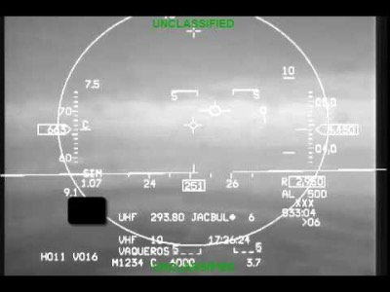
F-16 Close Call 5/5/16
[1]: Source, NASA Armstrong: https://www.youtube.com/watch?v=aSzXqlnT7nQ&embeds_euri=https%3A%2F%2Fwww.nasa.gov%2F&source_ve_path=MjM4NTE&feature=emb_title
Notes:
Hey Everyone welcome, let's start by watching a video This video is of a F-16 in 2016 almost crashing just a spoiler alert it doesn't crash and the pilot ends up being fine:
Alright so what did we just see. This video is of the HUD display of a student pilot from the Arizona Air National Guard’s 152nd Fighter Squadron, and the pilot executes a maneuver and because of the resulting 8.2 G forces the Pilot loses consciousness
About 11 seconds later the F-16 is pointed 50 degree below the horizon, going a little over the speed of sound at 11.8 thousand feet. In this situation the 'floor' is 12,000 feet which is considered the minimal acceptable altitude for the F-16 to be at.
Four seconds later the aircraft is at 8570 feet, so lost about 3500 feet in 4 seconds, and the AUTO-GCAS system activates, performing a 'Fly UP' maneuver at where it takes control of the F-16 while the pilot is incapacitated. The maneuver results in a force of 9.1 Gs, but it pulls the noise of the F-16 up and eventually the pilot recovers and the F-16 gets back above the 'floor' of 12,000 ft.
So Auto-Gcas eps the the automatic ground collision avoidance system that has been developed over several decades for situations like these, developed by Lockheed Martin and NASA Armstrong and the Airfare research laboratory not by my be at all). And what we just saw is an example of this technology saving a pilot's life.

Slide 14
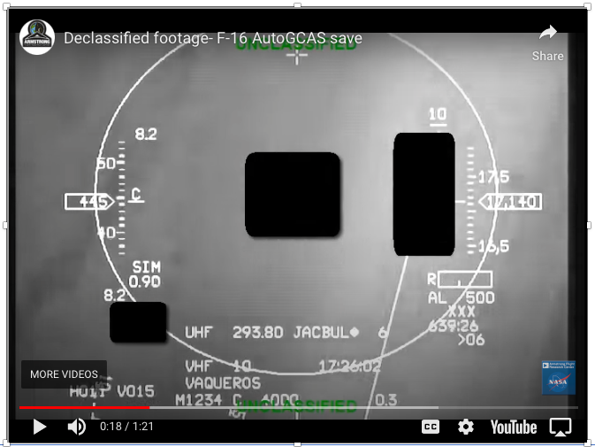
F-16 Close Call 5/5/16
Play-by-play
8.2 G Maneuver
18
Pilot loses
consciousness
30
33
38
41
65

Slide 15
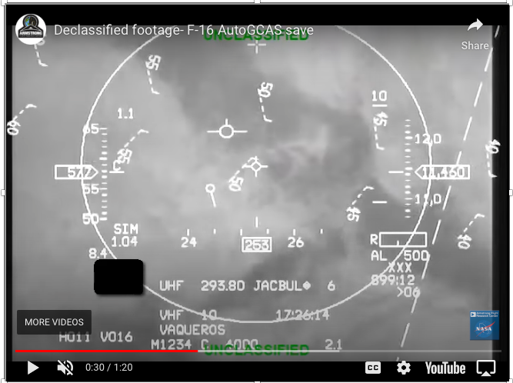
F-16 Close Call 5/5/16
Play-by-play
8.2 G Maneuver
18
Pilot loses
consciousness
30
Drops below ‘floor’
33
38
41
65

Slide 16
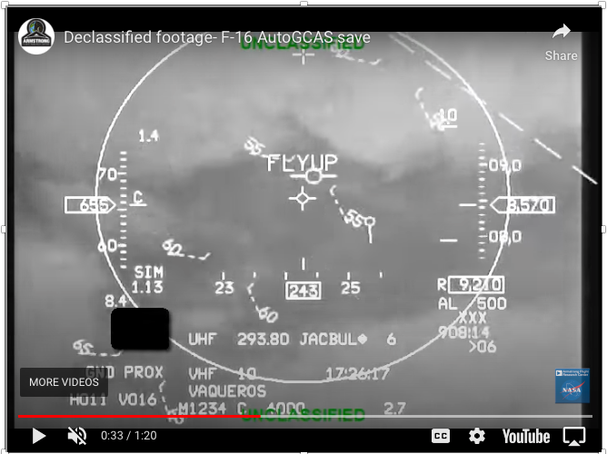
F-16 Close Call 5/5/16
Play-by-play
8.2 G Maneuver
18
Pilot loses
consciousness
30
Drops below ‘floor’
33
55º below horizon
Auto-GCAS
Activates
38
41
65
[2]: Auto GCAS, Lockheed Martin: https://www.lockheedmartin.com/en-us/products/autogcas.html

Slide 17
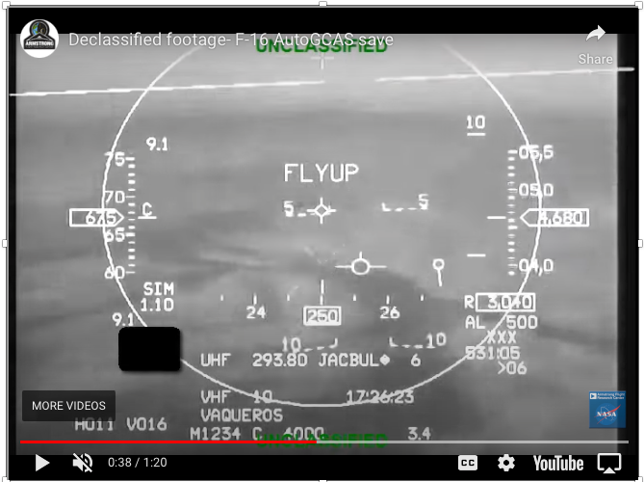
F-16 Close Call 5/5/16
Play-by-play
8.2 G Maneuver
18
Pilot loses
consciousness
30
Drops below ‘floor’
33
55º below horizon
Auto-GCAS
Activates
38
9 G maneuver
41
65

Slide 18
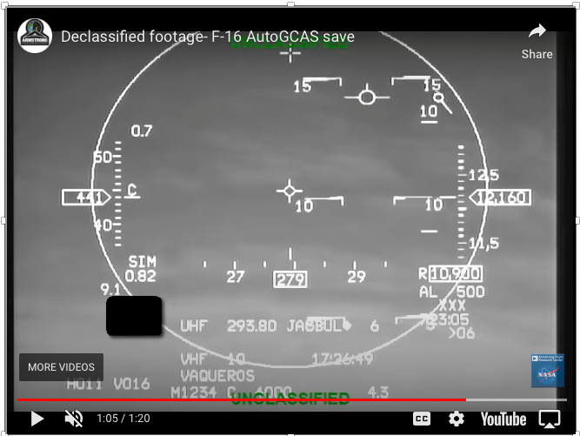
F-16 Close Call 5/5/16
Play-by-play
8.2 G Maneuver
18
Pilot loses
consciousness
29
Drops below ‘floor’
33
55º below horizon
Auto-GCAS
Activates
38
9 G maneuver
41
Back above ‘floor’
65

Slide 19
Runtime Assurance (RTA)
Untrusted
Advanced System
Output
Trusted
System
Being
Controlled
Input
RTA Monitor &
Switch Mechanism
Allocator
Output
Reversionary System
Trusted
Output
[2]: Runtime Assurance Framework Development For Highly Adaptive Flight Control Systems, SBIR Phase III Report, J.D. Schierman et. al. https://apps.dtic.mil/dtic/tr/fulltext/u2/1010277.pdf

Slide 20
Auto-GCAS
Untrusted
Human Pilot
Output
Input
RTA Monitor &
Switch Mechanism
Trusted
Flying an
F-16
Allocator
Output
Auto-GCAS
Trusted
Output
[3]: Run-Time Assurance: A Rising Technology, J. G. Fuller, 2020 DASC https://ieeexplore.ieee.org/document/9256425

Slide 21
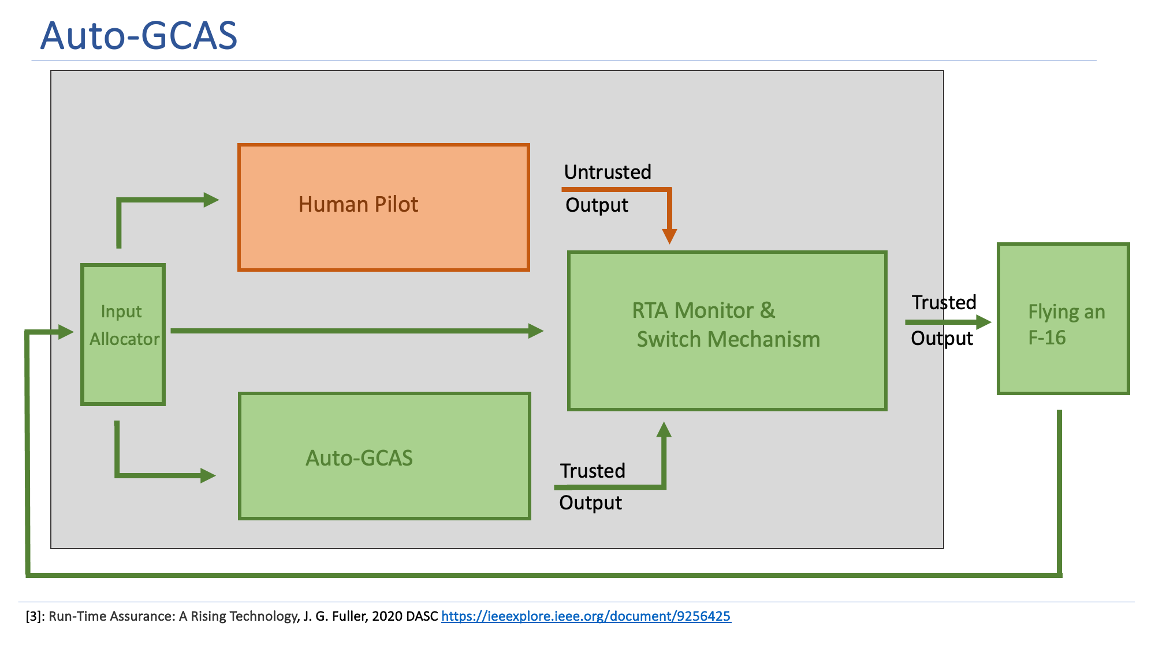
But wait!
How do we know
Auto-GCAS works?
RTA works?
F-16s work?
[3]: Run-Time Assurance: A Rising Technology, J. G. Fuller, 2020 DASC https://ieeexplore.ieee.org/document/9256425

Slide 22
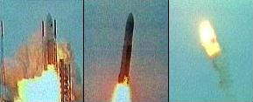
Safety- and Mission-critical Operations
Software
Aircraft (ex. detect and avoid)
Cybersecurity
Medical Equipment
Neural Networks, large language models
Hardware
Computer processors
Fingerprint readers
Avionics
Systems
National airspace/ urban airspace
Autonomous vehicles
Aircraft, Spacecraft
Power plants
Missile defense systems
Explosion of Ariane 5 rocket, 1996
Decade of development - $7 billion
Cargo – $500 million
Overflow error
Catastrophic failures can happen!
[4]: Why Is Formal Methods Necessary? LaRC FM Webpage: https://shemesh.larc.nasa.gov/fm/fm-why-new.html

Slide 23
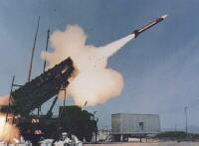
Safety- and Mission-critical Operations
Software
Aircraft (ex. detect and avoid)
Cybersecurity
Medical Equipment
Neural Networks, large language models
Hardware
Computer processors
Fingerprint readers
Avionics
Systems
National airspace/ urban airspace
Autonomous vehicles
Aircraft, Spacecraft
Power plants
Missile defense systems
Patriot Missile Failure, 1991
Missile defense system, failed to intercept missile
28 dead, 100 injured
Accumulation of Floating point error from constant execution
Catastrophic failures can happen!
[4]: Why Is Formal Methods Necessary? LaRC FM Webpage: https://shemesh.larc.nasa.gov/fm/fm-why-new.html

Slide 24

Safety- and Mission-critical Operations
Software
Aircraft (ex. detect and avoid)
Cybersecurity
Medical Equipment
Neural Networks, large language models
Hardware
Computer processors
Fingerprint readers
Avionics
Systems
National airspace/ urban airspace
Autonomous vehicles
Aircraft, Spacecraft
Power plants
Missile defense systems
Pentium FDIV bug, 1996
Defective Hardware Recall - $475 million
Division inaccurate beyond 3 digits
Catastrophic failures can happen!
[4]: Why Is Formal Methods Necessary? LaRC FM Webpage: https://shemesh.larc.nasa.gov/fm/fm-why-new.html

Slide 25

Safety- and Mission-critical Operations
Software
Aircraft (ex. detect and avoid)
Cybersecurity
Medical Equipment
Neural Networks, large language models
Hardware
Computer processors
Fingerprint readers
Avionics
Systems
National airspace/ urban airspace
Autonomous vehicles
Aircraft, Spacecraft
Power plants
Missile defense systems
Log4j Vulnerability, 2022
Loging software for Amazon Cloud Services,
Apple iCloud, Minecraft
User can log arbitrary code to run on target computer or server
Catastrophic failures can happen!
[5]: Apache Log4j Vulnerability Guidance, CISA, https://www.cisa.gov/news-events/news/apache-log4j-vulnerability-guidance

Slide 26
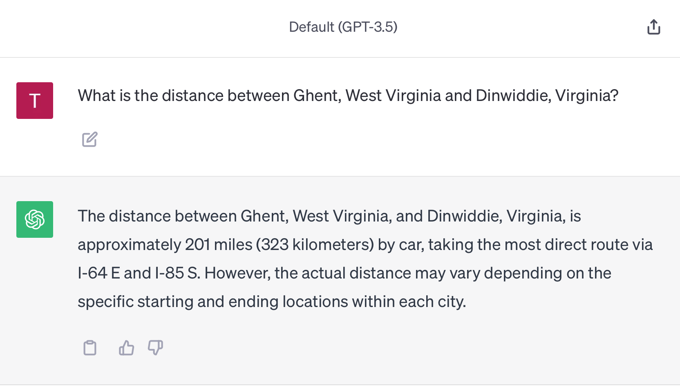
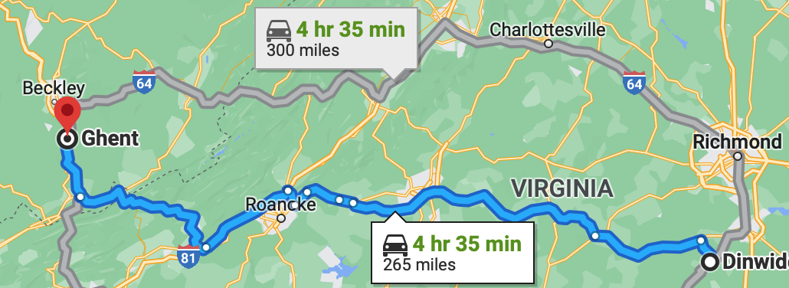
Safety- and Mission-critical Operations
Chat GPT:
Actual distance 194.89 miles
How can we assure critical software and hardware?
Wrong!

Slide 27
What is Formal Methods?
‘Applying mathematically rigorous techniques for specification and verification of software and/or hardware’
Formal specifications are well-formed statements in a mathematical logic
Formal verification uses a set of inference rules to prove properties of formal specifications
Experimentation is not enough in safety-critical applications
[6]: What is Formal Methods? LaRC FM Webpage https://shemesh.larc.nasa.gov/fm/fm-what.html

Slide 28
What is Formal Methods?
Let’s do some Formal Methods!!
[6]: What is Formal Methods? LaRC FM Webpage https://shemesh.larc.nasa.gov/fm/fm-what.html

Slide 29
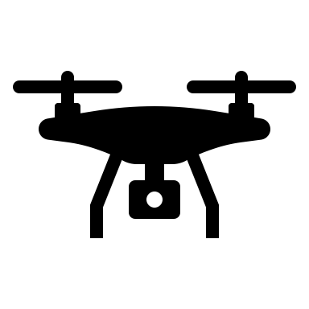


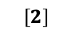
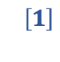
$$^{\left[1\right]}$$
Wildfire fighting operations require situational awareness
Unmanned aircraft system pilot kit (UASP-kit)
$$^{\left[2\right]}$$
Operational volumes (OV)
Mission area
Alerting volume
Alerting system
[7]: NASA System-Wide Safety Wildland Firefighting Operations Workshop Report, S. Lehman Et Al., Tech Report 2022, https://ntrs.nasa.gov/citations/20220014721 [8]: Developing an Unmanned Aircraft System Pilot Kit (UASP-kit) for Wildland Fire UAS Operators, L. Martin Et Al., AIAA AVIATION 2022

Slide 30

$$^{\left[1\right]}$$
Wildfire fighting operations require situational awareness
Unmanned aircraft system pilot kit (UASP-kit)
$$^{\left[2\right]}$$
Operational volumes (OV)
Mission area
Alerting volume
Alerting system
[7]: NASA System-Wide Safety Wildland Firefighting Operations Workshop Report, S. Lehman Et Al., Tech Report 2022, https://ntrs.nasa.gov/citations/20220014721 [8]: Developing an Unmanned Aircraft System Pilot Kit (UASP-kit) for Wildland Fire UAS Operators, L. Martin Et Al., AIAA AVIATION 2022

Slide 31

$$^{\left[1\right]}$$
Wildfire fighting operations require situational awareness
Unmanned aircraft system pilot kit (UASP-kit)
$$^{\left[2\right]}$$
Operational volumes (OV)
Mission area
Alerting volume
Alerting system
[7]: NASA System-Wide Safety Wildland Firefighting Operations Workshop Report, S. Lehman Et Al., Tech Report 2022, https://ntrs.nasa.gov/citations/20220014721 [8]: Developing an Unmanned Aircraft System Pilot Kit (UASP-kit) for Wildland Fire UAS Operators, L. Martin Et Al., AIAA AVIATION 2022

Slide 32

$$^{\left[1\right]}$$
Wildfire fighting operations require situational awareness
Unmanned aircraft system pilot kit (UASP-kit)
$$^{\left[2\right]}$$
Operational volumes (OV)
Mission area
Alerting volume
Alerting system
[7]: NASA System-Wide Safety Wildland Firefighting Operations Workshop Report, S. Lehman Et Al., Tech Report 2022, https://ntrs.nasa.gov/citations/20220014721 [8]: Developing an Unmanned Aircraft System Pilot Kit (UASP-kit) for Wildland Fire UAS Operators, L. Martin Et Al., AIAA AVIATION 2022

Slide 33

$$^{\left[1\right]}$$
Wildfire fighting operations require situational awareness
Unmanned aircraft system pilot kit (UASP-kit)
$$^{\left[2\right]}$$
Operational volumes (OV)
Mission area
Alerting volume
Alerting system
[7]: NASA System-Wide Safety Wildland Firefighting Operations Workshop Report, S. Lehman Et Al., Tech Report 2022, https://ntrs.nasa.gov/citations/20220014721 [8]: Developing an Unmanned Aircraft System Pilot Kit (UASP-kit) for Wildland Fire UAS Operators, L. Martin Et Al., AIAA AVIATION 2022

Slide 34

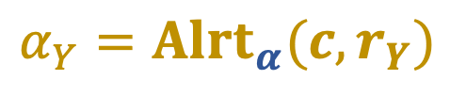
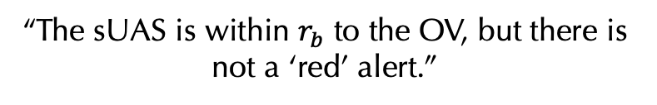
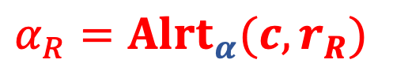

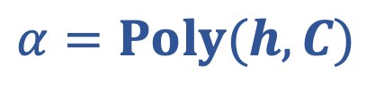
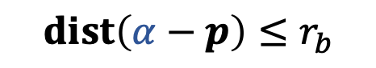
Scenario: comparing alerting volumes
$$α=Poly(h,C)$$
$$α_{R}=Alrt_{α}(c,r_{R})$$
$$α_{Y}=Alrt_{α}(c,r_{Y})$$
$$α⊄α_{R}$$
“The OV is not contained in the red
alerting volume.”
$$dist\left(α−p\right)≤r_{b}$$
$$p∉α_{R}$$
but
“The sUAS is within $r_{b}$ to the OV, but there is not a ‘red’ alert.”
[8]: Scenario based on Figure 7 in: Developing an Unmanned Aircraft System Pilot Kit (UASP-kit) for Wildland Fire UAS Operators, L. Martin Et Al., AIAA AVIATION 2022

Slide 35
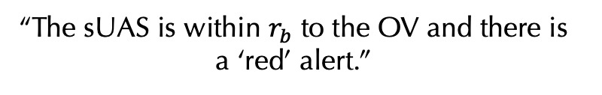
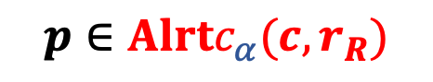

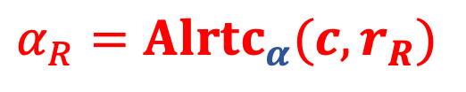
Scenario: comparing alerting volumes
$$α=Poly(h,C)$$
$$α_{R}=Alr{tc}_{α}(c,r_{R})$$
$$α_{Y}=Alrt_{α}(c,r_{Y})$$
$$α⊂α_{R}$$
“The OV is contained in the red
alerting volume.”
$$p∈Alrtc_{α}(c,r_{R})$$
“The sUAS is within $r_{b}$ to the OV and there is a ‘red’ alert.”
[8]: Scenario based on Figure 7 in: Developing an Unmanned Aircraft System Pilot Kit (UASP-kit) for Wildland Fire UAS Operators, L. Martin Et Al., AIAA AVIATION 2022

Slide 36
Scenario: comparing alerting volumes
$$α=Poly(h,C)$$
$$α_{R}=Alr{tc}_{α}(c,r_{R})$$
$$α_{Y}=Alrt_{α}(c,r_{Y})$$
$$α⊂α_{R}$$
“The OV is contained in the red
alerting volume.”
$$p∈Alrtc_{α}(c,r_{R})$$
“The sUAS is within $r_{b}$ to the OV and there is a ‘red’ alert.”
[8]: Scenario based on Figure 7 in: Developing an Unmanned Aircraft System Pilot Kit (UASP-kit) for Wildland Fire UAS Operators, L. Martin Et Al., AIAA AVIATION 2022

Slide 37
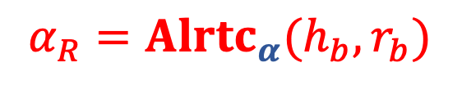
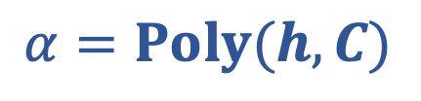
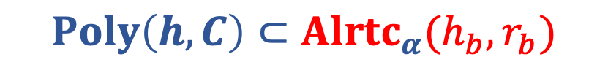
Operational volumes (OVs)
Result: formal verification of OVs
OVs as datatype in PVS
Algorithms
Point-in
Intersection & containment
Example: Let
$$α=Poly(h,C)$$
$$α_{R}=Alr{tc}_{α}(h_{b}, r_{b})$$
then
$$Poly\left(h,C\right)⊂Alr{tc}_{α}(h_{b}, r_{b})$$
“The conforming alerting volume contains the polygon.”
[9]: Formalized Reasoning of Operational Volumes for Wildland Fire Fighting, J Tanner Slagel Et Al., AIAA AVIATION 2023

Slide 38

Operational volumes (OVs)
$$p$$
Result: formal verification of OVs
OVs as datatype in PVS
Algorithms
Point-in
Intersection & containment
Example: Let
$$α=Poly(h,C)$$
$$α_{R}=Alr{tc}_{α}(h_{b}, r_{b})$$
then
$$dist\left(α−p\right)≤r_{b} \text{implies} p∈Alr{tc}_{α}(h_{b}, r_{b})$$
“If a point has a distance to the polygon of at most $r_{b}$, then that point is in the alerting volume ”
[9]: Formalized Reasoning of Operational Volumes for Wildland Fire Fighting, J Tanner Slagel Et Al., AIAA AVIATION 2023

Slide 39
Formal Methods

Slide 40

Geofenced Operations
Reversionary System
Advanced System

Slide 41
Geofenced Operations
Untrusted
Complex Path
Output
Operating a
fix-winged
aircraft
Input
RTA Monitor &
Switch Mechanism
Allocator
Return to safe zone dynamics
Trusted
Output

Slide 42
How do we model and analyze these systems at design time?
Geofenced Operations
Untrusted
Complex Path
Output
Operating a
fix-winged
aircraft
Input
RTA Monitor &
Switch Mechanism
Allocator
Return to safe zone dynamics
Trusted
Output

Slide 43
Hybrid Programs and Differential Dynamic Logic

Slide 44
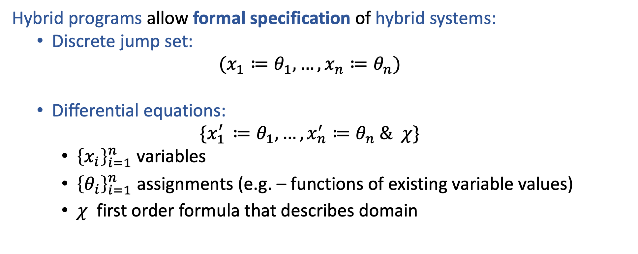
Hybrid Programs
Hybrid programs allow formal specification of hybrid systems:
Discrete jump set:
$$(x_{1}≔θ_{1}, …, x_{n}≔θ_{n})$$
Differential equations:
$$\{x_{1^{ }}^{′}≔θ_{1}, …, x_{n}^{′}≔θ_{n} \& χ\}$$
${\left\{x_{i}\right\}}_{i=1}^{n}$ variables
${\left\{θ_{i}\right\}}_{i=1}^{n}$ assignments (e.g. – functions of existing variable values)
$χ$ first order formula that describes domain
Example:
$$\left(x≔0^{ }, y≔c^{ }\right);\left\{x^{′}=y, y^{′}=−x \& y≥0\right\}$$

Slide 45
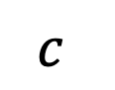
Hybrid Programs
$$y$$
$$c^{ }$$
$$x$$
Example:
$$\left(x≔0^{ }, y≔c^{ }\right);\left\{x^{′}=y, y^{′}=−x \& y≥0\right\}$$

Slide 46
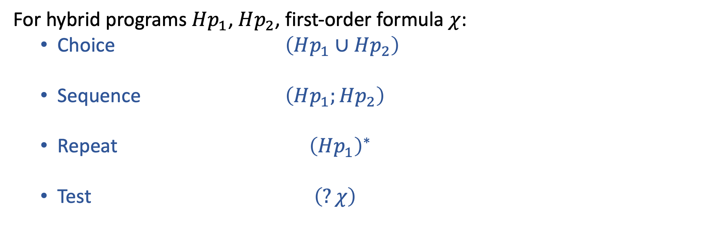
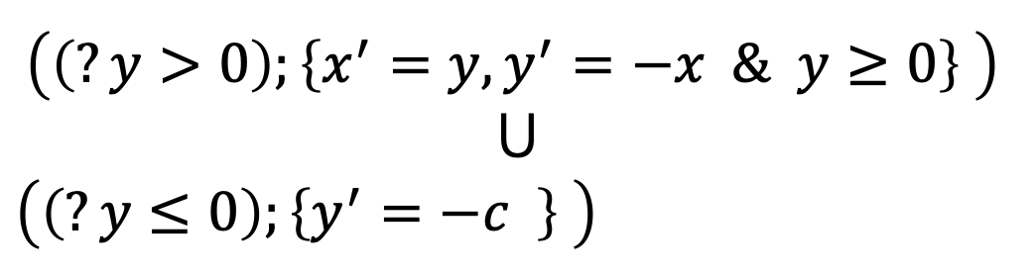
Hybrid Programs (continued)
For hybrid programs $Hp_{1}$, $Hp_{2}$, first-order formula $χ$:
Choice $\left(Hp_{1}∪Hp_{2}\right)$
Sequence $\left(Hp_{1};Hp_{2}\right)$
Repeat ${\left(Hp_{1}^{ }\right)}^{∗}$
Test $\left(?χ\right)$
$${\left(\left(?y>0\right);\left\{x^{′}=y, y^{′}=−x \& y≥0\right\} \right)}^{ }$$
$$⋃$$
${\left(\left(?y≤0\right);\left\{y^{′}=−c^{ } \right\} \right)}^{ }$
*
Example:

Slide 47
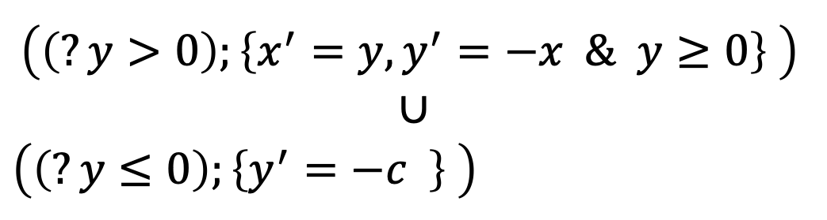
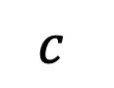

Hybrid Programs (continued)
$$y$$
$$c^{ }$$
$$x$$
$${\left(\left(?y>0\right);\left\{x^{′}=y, y^{′}=−x \& y≥0\right\} \right)}^{ }$$
$$∪$$
${\left(\left(?y≤0\right);\left\{y^{′}=−c^{ } \right\} \right)}^{ }$
*
Example:

Slide 48
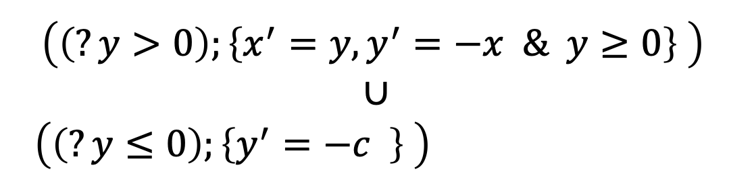
Hybrid Programs (continued)
$$y$$
$$c^{ }$$
$$x$$
$${\left(\left(?y>0\right);\left\{x^{′}=y, y^{′}=−x \& y≥0\right\} \right)}^{ }$$
$$∪$$
${\left(\left(?y≤0\right);\left\{y^{′}=−c^{ } \right\} \right)}^{ }$
*
Example:

Slide 49
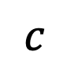
Hybrid Programs (continued)
$$y$$
$$c^{ }$$
This is a Dubins path!
$$x$$
$${\left(\left(?y>0\right);\left\{x^{′}=y, y^{′}=−x \& y≥0\right\} \right)}^{ }$$
$$∪$$
${\left(\left(?y≤0\right);\left\{y^{′}=−c^{ } \right\} \right)}^{ }$
*
Example:

Slide 50
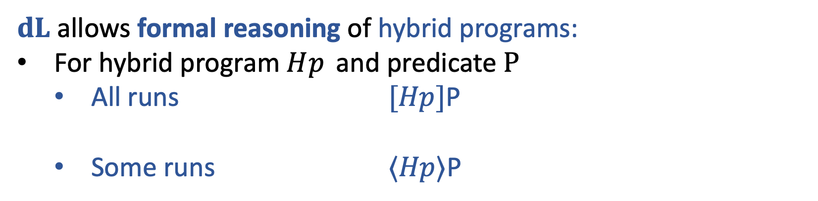



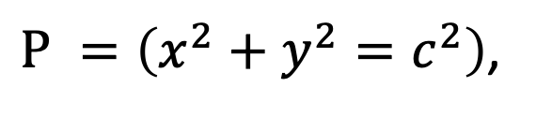
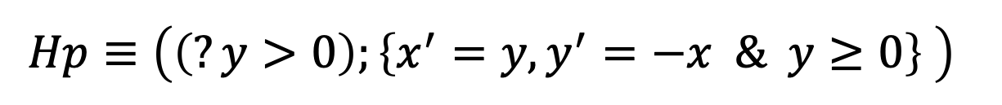
$dL$: Differential Dynamic Logic
$dL$allows formal reasoning of hybrid programs:
For hybrid program $Hp_{ }$ and predicate $P$
All runs $[Hp]$P
Some runs $⟨Hp⟩$P
Example: Let
$${Hp≡{\left(\left(?y>0\right);\left\{x^{′}=y, y^{′}=−x \& y≥0\right\} \right)}^{ }}^{ }$$
$P^{ }=\left(x^{2}+y^{2}=c^{2}\right)$,
then
$y=c^{ },x=0→\left[Hp\right]P$
$y=c^{ },x=0→⟨Hp⟩(y=0)$

Slide 51
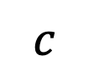



$dL$: Differential Dynamic Logic
$$y$$
$$c^{ }$$
$$x$$
Example: Let
$${Hp≡{\left(\left(?y>0\right);\left\{x^{′}=y, y^{′}=−x \& y≥0\right\} \right)}^{ }}^{ }$$
$P^{ }=\left(x^{2}+y^{2}=c^{2}\right)$,
then
$y=c^{ },x=0⊢\left[Hp\right]P$
$y=c^{ },x=0⊢⟨Hp⟩(y=0)$

Slide 52

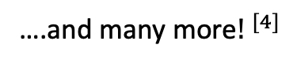
$dL$: Differential Dynamic Logic – Rule Schema
Union axiom:
Loop rule:
Differential invariant
rule:
….and many more${! }^{[4]}$
[10] Differential Dynamic Logic, Logical Foundations of Cyber-Physical Systems. André Platzer. 2018 https://doi.org/10.1007/978-3-319-63588-0
[11] $dL$ “Cheat Sheet,” André Platzer, https://symbolaris.com/logic/dL-sheet.pdf

Slide 53

$dL$: Proof
Differential invariant
rule:
$$y=c^{ },x=0 ⊢[{\{x}^{′}=y, y^{′}=−x\}](x^{2}+y^{2}=c^{2})$$
[10] Differential Dynamic Logic, Logical Foundations of Cyber-Physical Systems. André Platzer. 2018 https://doi.org/10.1007/978-3-319-63588-0
[11] $dL$ “Cheat Sheet,” André Platzer, https://symbolaris.com/logic/dL-sheet.pdf

Slide 54

$dL$: Proof
Differential invariant
rule:
$$y=c^{ },x=0 ⊢[{\{x}^{′}=y, y^{′}=−x\}](x^{2}+y^{2}=c^{2})$$
[10] Differential Dynamic Logic, Logical Foundations of Cyber-Physical Systems. André Platzer. 2018 https://doi.org/10.1007/978-3-319-63588-0
[11] $dL$ “Cheat Sheet,” André Platzer, https://symbolaris.com/logic/dL-sheet.pdf

Slide 55
$dL$: Proof
Differential invariant
rule:
$$y=c, x=0 ⊢x^{2}+y^{2}=c^{2}$$
$$⊢[x^{′}:=y, y^{′}:=−x](2 x^{ }x′+{2 y y′}^{ }=0)$$
Apply Di rule
$$y=c^{ },x=0 ⊢[{\{x}^{′}=y, y^{′}=−x\}](x^{2}+y^{2}=c^{2})$$
[10] Differential Dynamic Logic, Logical Foundations of Cyber-Physical Systems. André Platzer. 2018 https://doi.org/10.1007/978-3-319-63588-0
[11] $dL$ “Cheat Sheet,” André Platzer, https://symbolaris.com/logic/dL-sheet.pdf

Slide 56
$dL$: Proof
Differential invariant
rule:
$$⊢ {0^{2}}^{ }+{ c^{2} }^{ }=c^{2}$$
$$⊢2 x^{ }y+{2 y \left(−x\right)}^{ }=0$$
Apply
substitution
$$y=c, x=0 ⊢x^{2}+y^{2}=c^{2}$$
$$⊢[x^{′}:=y, y^{′}:=−x](2 x^{ }x′+{2 y y′}^{ }=0)$$
Apply Di rule
$$y=c^{ },x=0 ⊢[{\{x}^{′}=y, y^{′}=−x\}](x^{2}+y^{2}=c^{2})$$
[10] Differential Dynamic Logic, Logical Foundations of Cyber-Physical Systems. André Platzer. 2018 https://doi.org/10.1007/978-3-319-63588-0
[11] $dL$ “Cheat Sheet,” André Platzer, https://symbolaris.com/logic/dL-sheet.pdf

Slide 57

$dL$: Proof
Differential invariant
rule:
$$⊢0=0$$
Arithmetic!
$$⊢2 x^{ }y+{2 y \left(−x\right)}^{ }=0$$
$$⊢ {0^{2}}^{ }+{ c^{2} }^{ }=c^{2}$$
Apply
substitution
$$y=c, x=0 ⊢x^{2}+y^{2}=c^{2}$$
$$⊢[x^{′}:=y, y^{′}:=−x](2 x^{ }x′+{2 y y′}^{ }=0)$$
Apply Di rule
$$y=c^{ },x=0 ⊢[{\{x}^{′}=y, y^{′}=−x\}](x^{2}+y^{2}=c^{2})$$
[10] Differential Dynamic Logic, Logical Foundations of Cyber-Physical Systems. André Platzer. 2018 https://doi.org/10.1007/978-3-319-63588-0
[11] $dL$ “Cheat Sheet,” André Platzer, https://symbolaris.com/logic/dL-sheet.pdf

Slide 58

dL
Plaidypvs
[12] Towards an Implementation of Differential Dynamic Logic in PVS, SOAP 2022, Slagel et. al. https://dl.acm.org/doi/abs/10.1145/3520313.3534661
Notes:
Properly Assured Implementation of Differential Dynamic Logic from hybrid programs verification and specification

Slide 59
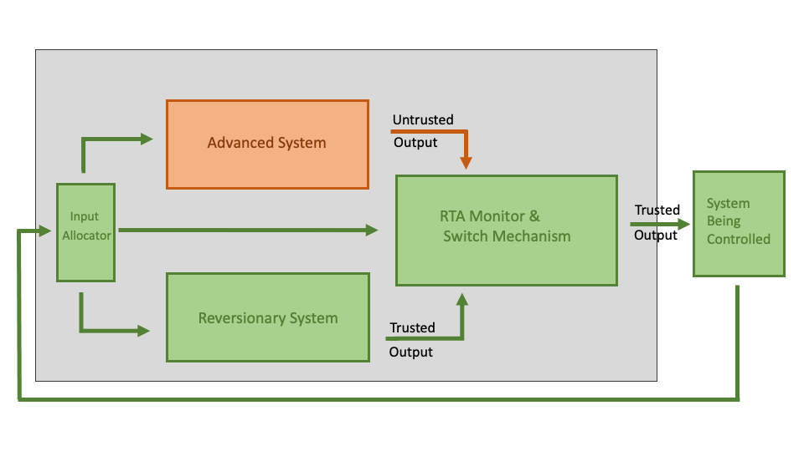
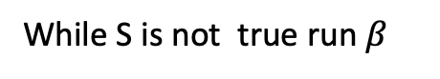
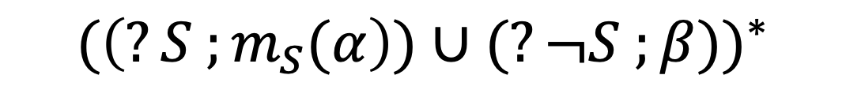
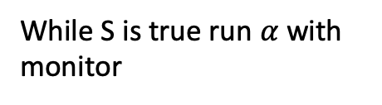
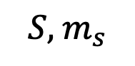
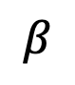
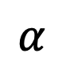
RTA in Plaidypvs
$$α$$
$$S, { m}_{s}$$
$$β$$
Example: Define
$${(\left(?S ;m_{S}(α\right))∪(?¬S ;β))}^{∗}$$
While S is true run $α$with monitor
and
While S is not true run $β$

Slide 60
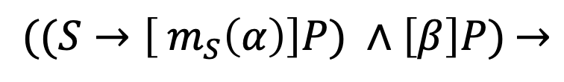
RTA in Plaidypvs
$$α$$
$$S, { m}_{s}$$
$$β$$
Example:
$${((S→\left[ m_{S}\left(α\right)\right]P) ∧\left[β\right]P)}^{ }→$$
$${[(\left(?S ;m_{S}(α\right))∪(?¬S ;β))}^{∗}] P$$
“If $α$ is safe in S and $β$ is always safe, then the RTA architecture is always safe”

Slide 61






Geofenced Operations (simplified)
$$R$$
Reversionary System
Advanced System
$$Y$$
$$B$$
$$x^{′}=f_{x},$$
$$y^{′}=f_{y}$$
$$\begin{aligned}x^{′}=−w \left(y−y_{0}\right)+f_{0,x} \\ y^{′}=w \left(x−x_{0}\right)+f_{0,y }\end{aligned}$$
$$\frac{2\sqrt{2}v_{max}}{w}$$

Slide 62







Geofence RTA
$${[(\left(?S ;m_{S}(α\right)∪(?¬S ;m_{S}(β)))}^{∗}] P$$
$${[(\left(?B ;{ m_{B}(α) }_{ }\right)∪(?¬B ; β))}^{∗}]¬R$$
“The aircraft never goes into the red region ”
$$x^{′}=f_{x},$$
$$y^{′}=f_{y}$$
$$α=$$
and
$$\begin{aligned}x^{′}=−w \left(y−y_{0}\right)+f_{0,x} \\ y^{′}=w \left(x−x_{0}\right)+f_{0,y }\end{aligned}$$
$$β=$$
$${bdry?\left(B\right)→⟨ (?¬B ; β))}^{∗}⟩B$$
“If the aircraft exits the blue region, it will
Eventually return to the blue region ”
$$B$$
$$\frac{2\sqrt{2}v_{max}}{w}$$
$$R$$
$$Y$$

Slide 63
Conclusion
Formal Methods can be used to assure safety- and mission-critical systesms
Thank you for paying attention!
Questions, comments?
J.Tanner.Slagel@nasa.gov
[6]: What is Formal Methods? LaRC FM Webpage https://shemesh.larc.nasa.gov/fm/fm-what.html

Slide 64

Old Abstract

